Slide 1
Saint Petersburg restaurant location
By Artem f., 2020

Slide 2
Need to find the best high cuisine venue place with:
Focus on customers with high-income
Total population of districts
Less possible competitive venues along the area
Venue's cuisine IDEAS for district

Slide 3
Data
Foursquare data about venues (via Foursquare API)
Administrative divisions of Saint Petersburg (parsed directly from Wikipedia with BeautifulSoup4 library)
Statistics data of average income from Official Statistics Department of Russia in Saint Petersburg from jan to sept 2018
Price of land from Rusland SP
Price of land from “Restate” agency

Slide 4
Basic data compilation
 | DNumber | District | Population | Square | Density | Latitude | Longitude | Income | RentCost | FlatCostPerM | FCChange
0 | 1 | Адмиралтейский | 159795 | 13.82 | 11562.599609 | 59.916824 | 30.297542 | 81481 | 1408.8 | 136000.0 | 0.205
1 | 2 | Василеостровский | 207482 | 21.47 | 9663.799805 | 59.941425 | 30.248045 | 71982 | 4684.6 | 110000.0 | -0.057
2 | 3 | Выборгский | 522746 | 115.52 | 4525.200195 | 60.050449 | 30.328696 | 64784 | 1121.1 | 117000.0 | 0.330
3 | 4 | Калининский | 529187 | 40.18 | 13170.400391 | 59.997684 | 30.396824 | 61920 | 1065.7 | 110000.0 | 0.085
4 | 5 | Кировский | 336157 | 47.46 | 7083.000000 | 59.876392 | 30.257603 | 60380 | 1055.7 | 109500.0 | 0.232

Slide 5
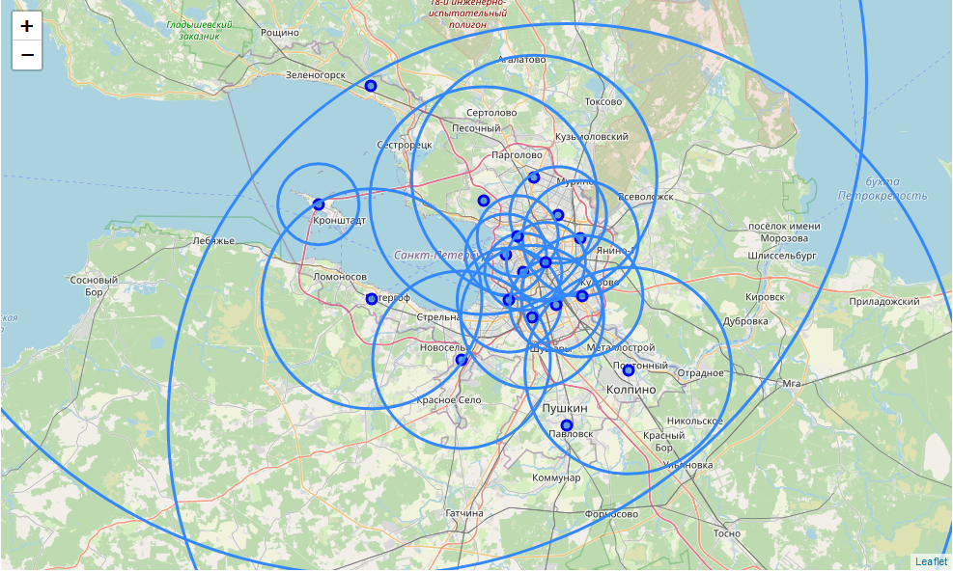
Collecting venues from Foursquare
Foursquare API queries are limited
We need to find best Radius for venues search
Building Voronoi diagram and closest vertice calculation
R-function (geometric)
R-function (with square)
R-mean (limited to 12k)

Slide 6

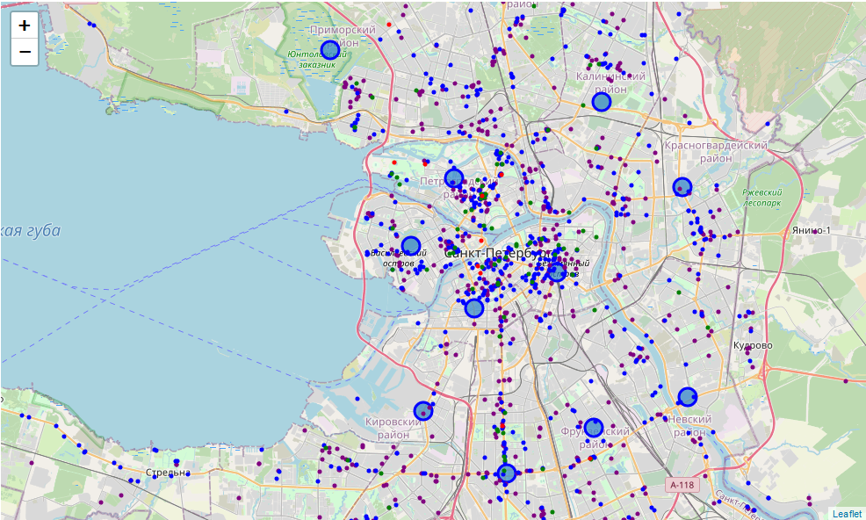
Collecting venues
Major steps:
Collecting data for each Districts
Calculating best Venue/District match according to the distance
Removing duplicates

Slide 7

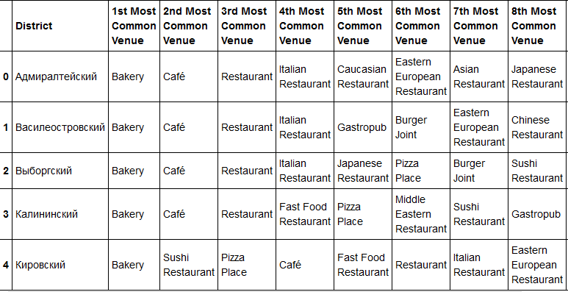



Next step: Building rating of venues for Districts

Slide 8
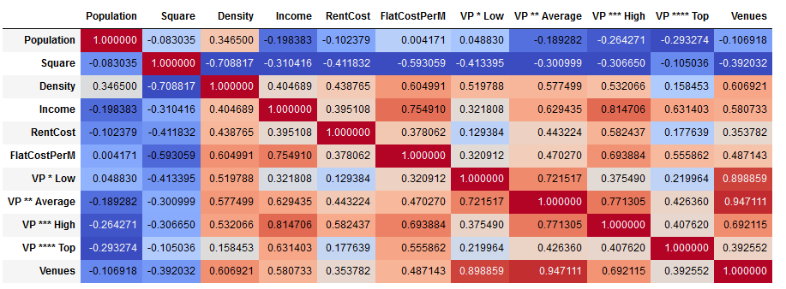
Feature selection from Correlation Matrix

Slide 9
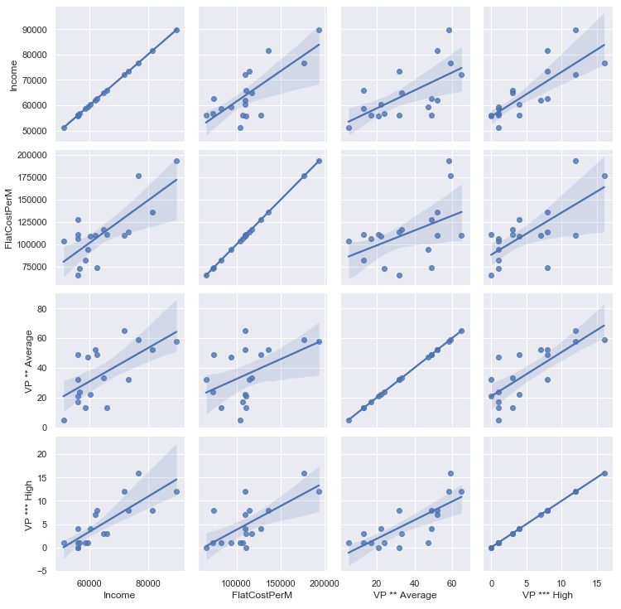
Beast features correlation plots

Slide 10
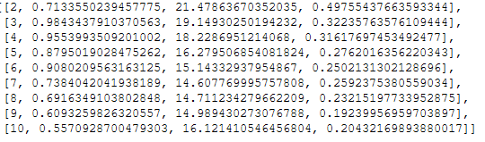
Finding the best K for KMean clustering algorithm
Preprocess Features data for a model
Scores:
Davies Bouldin
Calinski Harabasz
Silhouette score
Best cluster value is 2

Slide 11
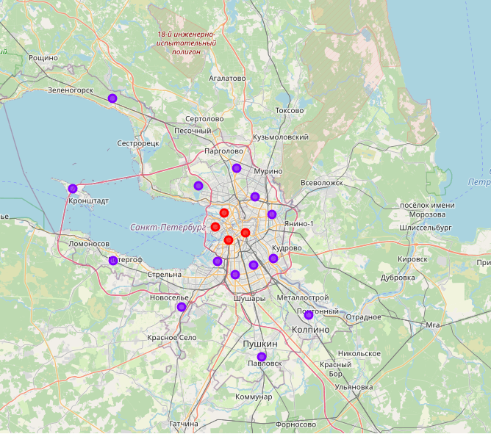
Building a clustering model for Districts (k = 2)

Slide 12
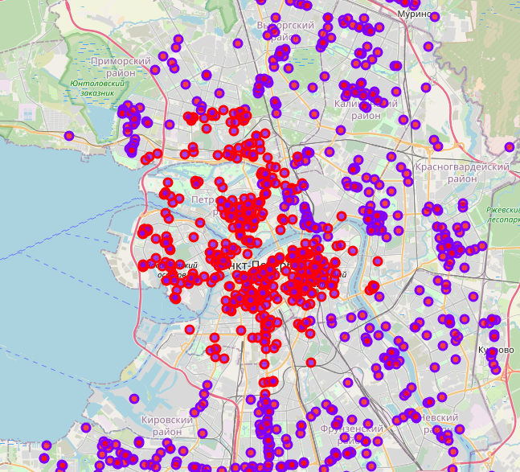
Browsing venues in different clusters

Slide 13
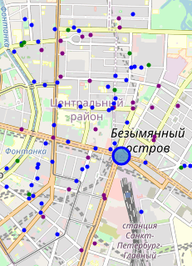
Best match: Centralniy dst.
Avg income rate is very high
No competitive venues along the area
There are over 200k population

Slide 14
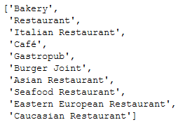
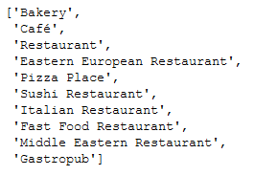
Cross-check venues for result District
District top10
City top10

Slide 15
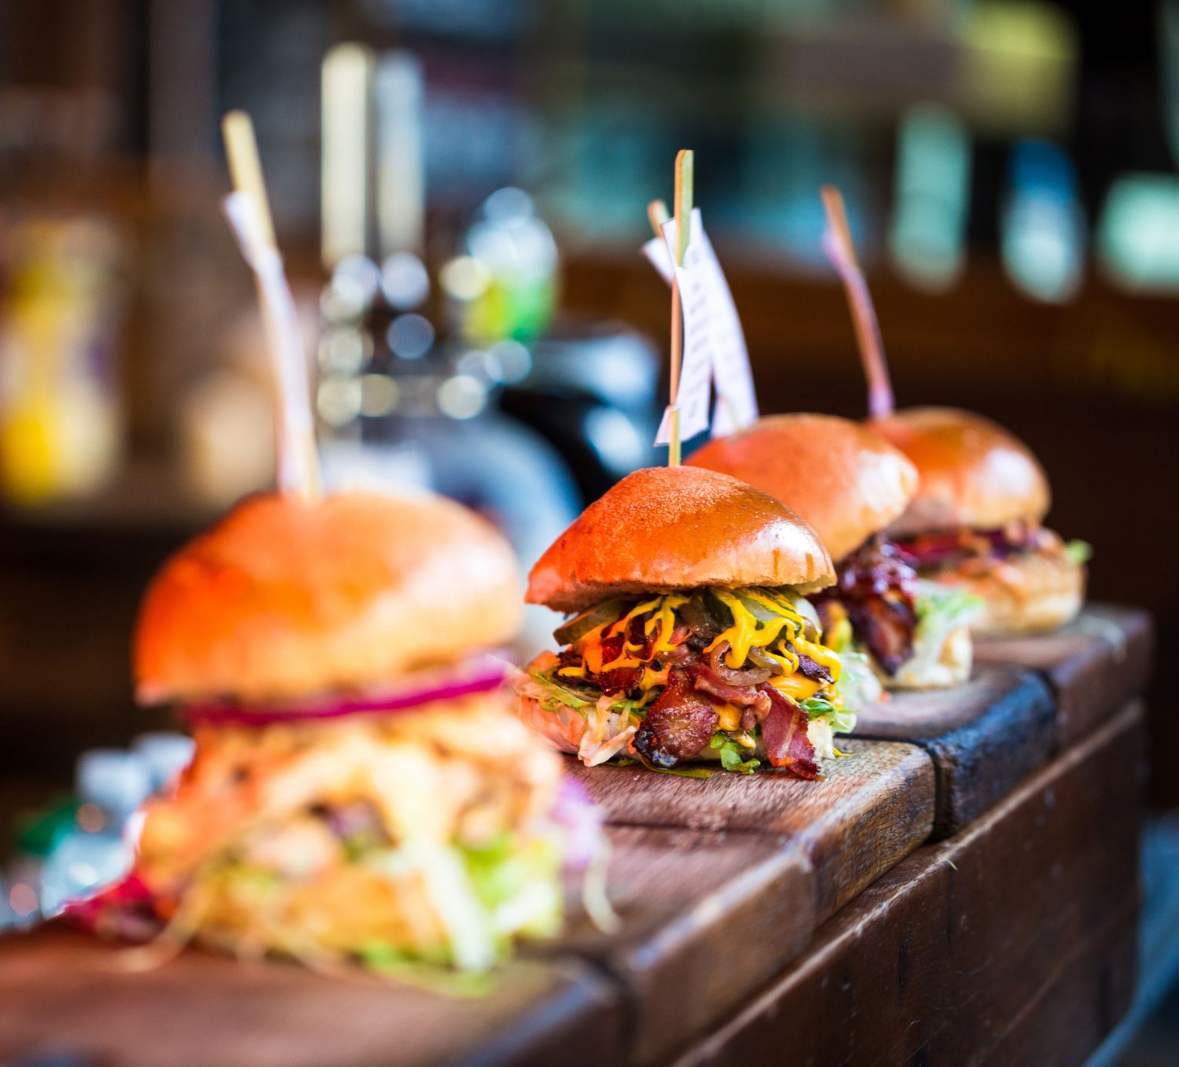
The best match for a new venue (according to city top):
Pizza Place
Sushi Restaurant
Middle Eastern Restaurant
Fast Food Restaurant

Slide 16

Possible drawbacks
Incomplete or wrong venue data in Foursquare
Minor Radius inaccuracies
Venue assignment to the District may be inaccurate due to direct distance calculation and the results may be improved by smart distance matrix
Venue type selection uses data from all price type venues and may be too noisy as high cuisine restaurants share is low in comparison with all dataset
We don’t have enough data to evaluate venue type as there is no targeted customers data

Slide 17
Conclusion
This project has approved our main point and made predictions for a central location in Saint-Petersburg. Also it described tastes of Saint-Petersburg citizens which can be used for future investment.

